Slide 1
Linear Filtering
Chul Min Yeum
Assistant Professor
Civil and Environmental Engineering
University of Waterloo, Canada
CIVE 497 – CIVE 700: Smart Structure Technology
Last updated: 2018-02-06

Slide 2
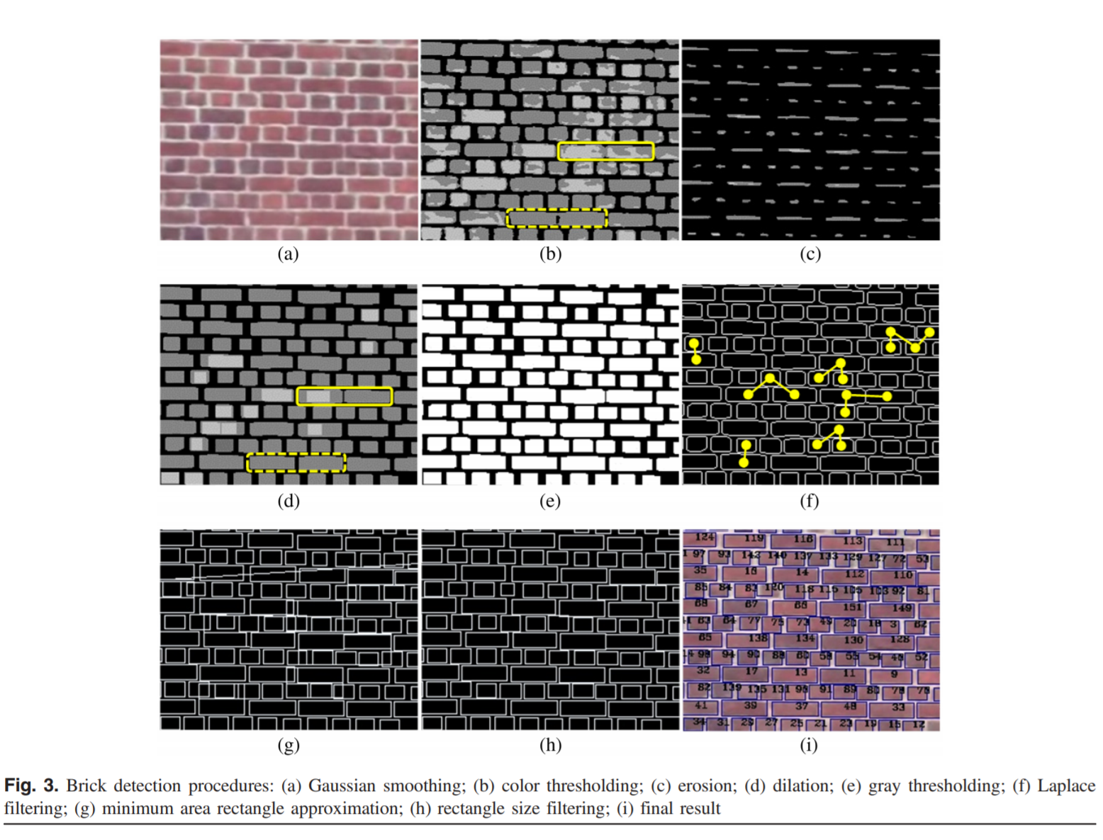
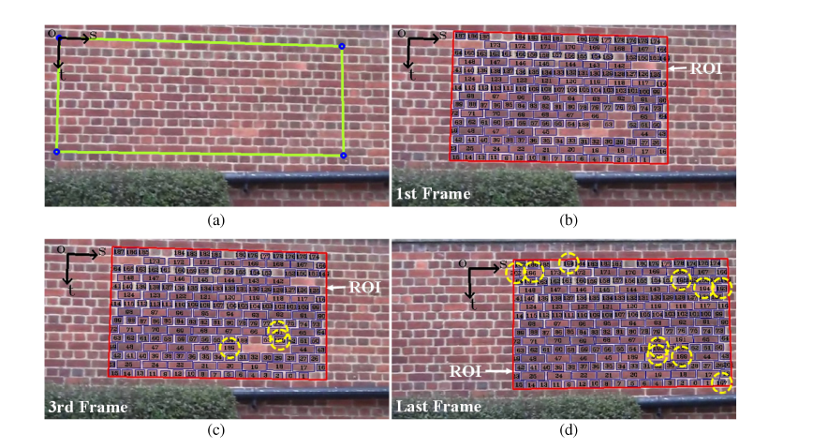
Automated Brick Counting for Façade Construction Progress Estimation
https://ascelibrary.org/doi/pdf/10.1061/%28ASCE%29CP.1943-5487.0000423
Notes:
https://ascelibrary.org/doi/pdf/10.1061/%28ASCE%29CP.1943-5487.0000423

Slide 3
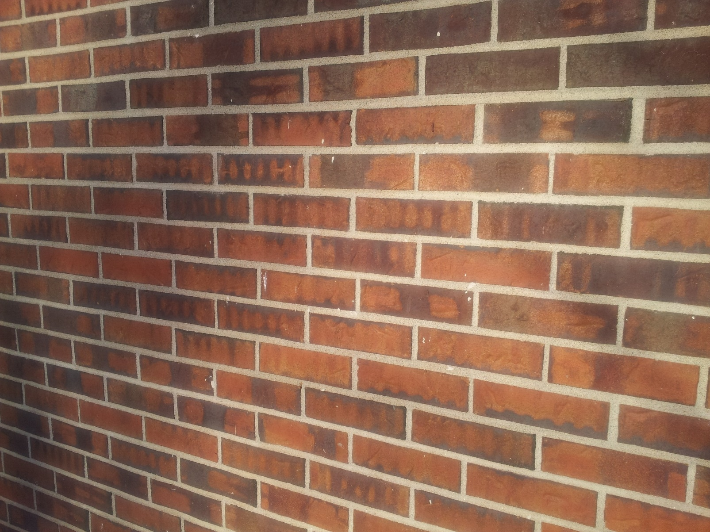
How Can We Count the Blocks?

Slide 4

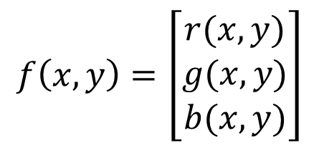
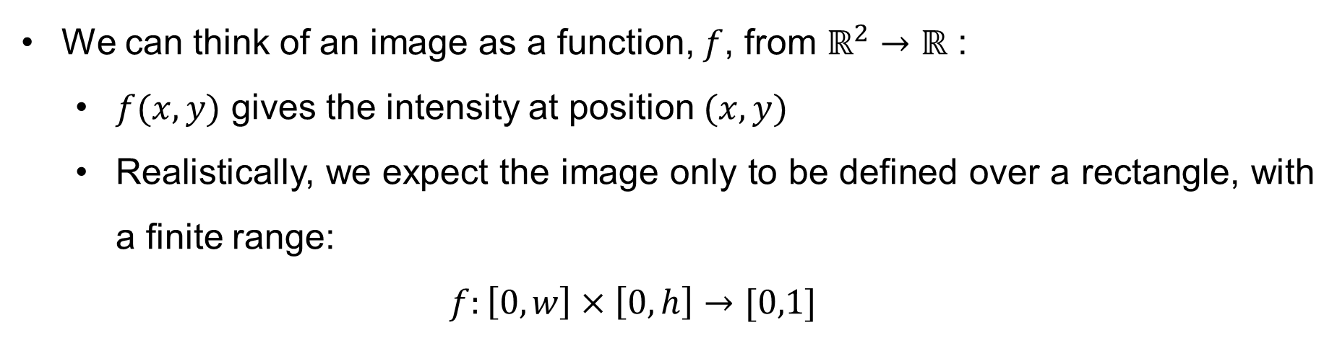
Image as Functions
We can think of an image as a function, $f$, from $ℝ^{2}→ℝ$ :
$f(x,y)$ gives the intensity at position $(x,y)$
Realistically, we expect the image only to be defined over a rectangle, with a finite range:
$$f:\left[0,w\right]×\left[0,h\right]→[0,1]$$
A color image is just three functions pasted together.
$$f\left(x,y\right)=\left[\begin{matrix}r(x,y) \\ g(x,y) \\ b(x,y)\end{matrix}\right]$$

Slide 5

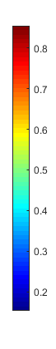
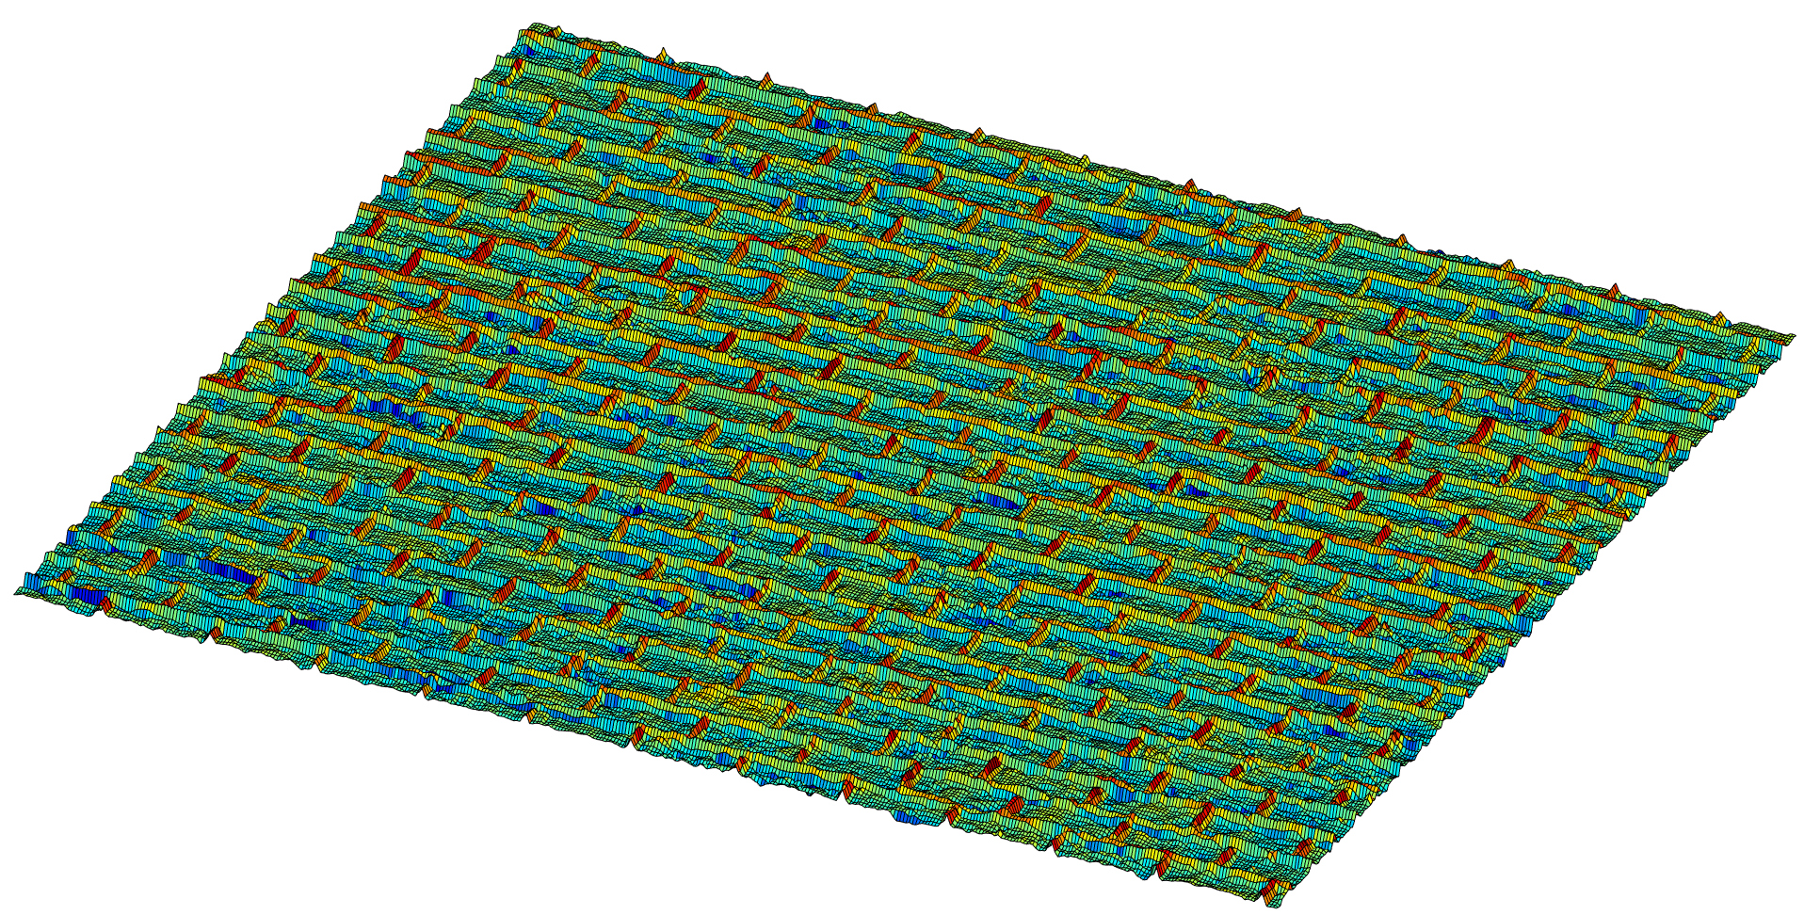
Image as Functions (Continue)
RGB
f(X, Y)
X
Y
Gray

Slide 6
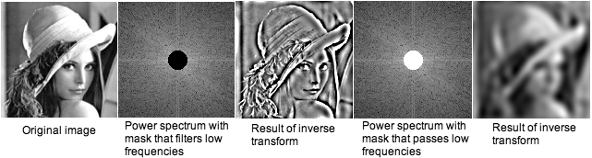
Image Interpreted in a Frequency Domain
Convolution!!
https://imagej.nih.gov/ij/docs/images/fft.jpg

Slide 7
Linear Filtering
One simple version : linear filtering (cross-correlation or convolution)
Replace each pixel by a linear combination of its neighbors
The prescription for the linear combination is called the “kernel” (or “mask” or “filtering”)
1 | 1 | 1
1 | 1 | 1
1 | 1 | 1
1 | 1 | 1
1 | 1 | 1
1 | 1 | 1
0 | 0 | 0
0 | 9 | 0
0 | 0 | 0
Local image data
Kernal
Modified image data

Slide 8
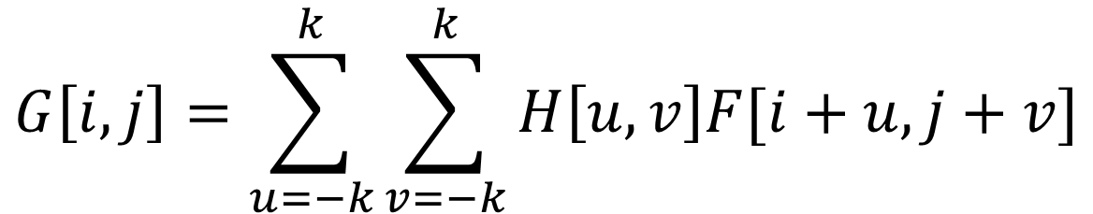
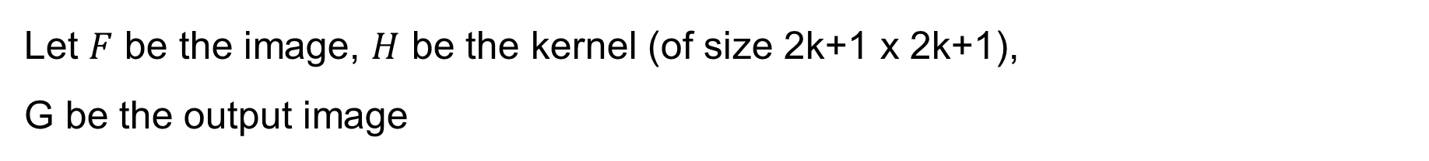
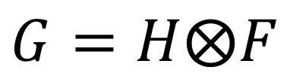
Cross-Correlation
Let $F$ be the image, $H$ be the kernel (of size 2k+1 x 2k+1),
G be the output image
$$G\left[i,j\right]=\sum_{u=−k}^{k}{\sum_{v=−k}^{k}{H\left[u,v\right]F[i+u,j+v]}}$$
This is called a cross-correlation operation:
$$G=H⨂F$$

Slide 9
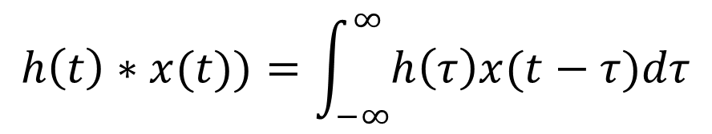
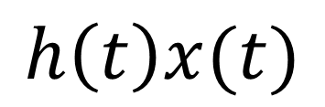
Example: Signal Processing
$$h\left(t\right)x(t)$$
$$h\left(t\right)∗x(t))=\int_{−∞}^{∞}{h\left(τ\right)x(t−τ)dτ}$$

Slide 10
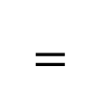

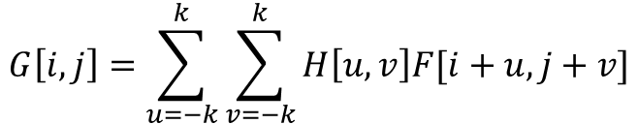
Cross-Correlation (Continue)
Cross-correlation is a measure of similarity between two images. Cross correlation with a kernel can be viewed as comparing a litter “picture” or “region” of what you want to find across all sub-regions in the image.
$$G\left[i,j\right]=\sum_{u=−k}^{k}{\sum_{v=−k}^{k}{H\left[u,v\right]F[i+u,j+v]}}$$
0 | 0 | 0 | 1 | 0 | 0 | 0
0 | 1 | 1 | 1 | 0 | 0 | 0
0 | 1 | 1 | 1 | 0 | 1 | 1
0 | 1 | 1 | 1 | 1 | 0 | 0
0 | 0 | 0 | 0 | 1 | 0 | 0
0 | 1 | 0 | 0 | 0 | 0 | 0
0 | 0 | 0 | 0 | 1 | 1 | 1
4 | 7 | 5 | 4 | 2
6 | 9 | 7 | 5 | 3
4 | 6 | 6 | 5 | 4
3 | 4 | 4 | 3 | 2
1 | 1 | 2 | 3 | 4
1 | 1 | 1
1 | 1 | 1
1 | 1 | 1
$$⨂$$
$$=$$

Slide 11
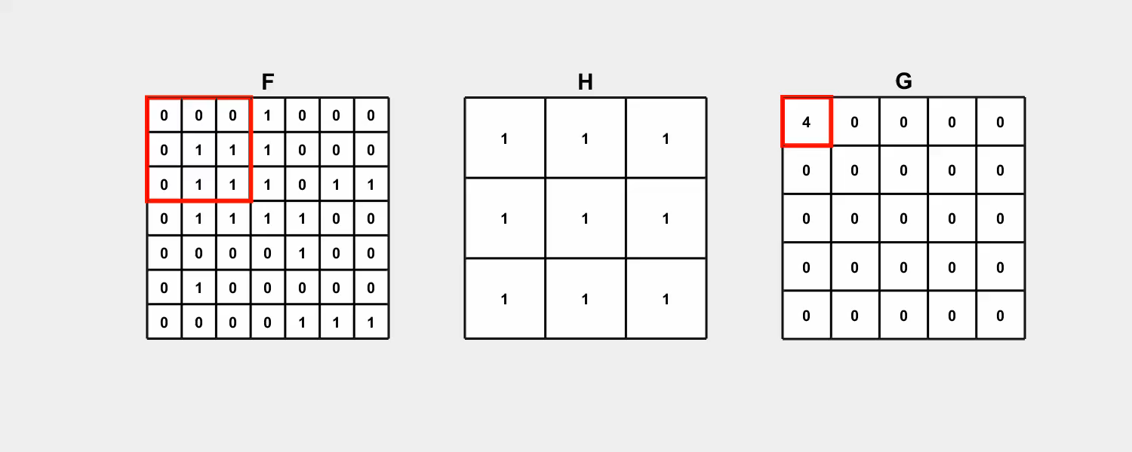
Computation of the Cross-Correlation Between Two Matrices

Slide 12
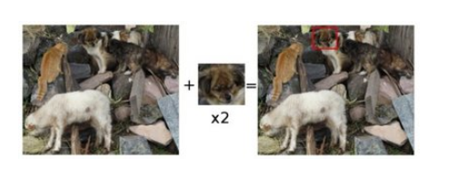
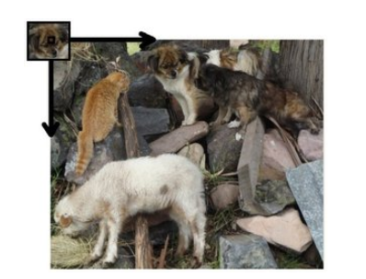
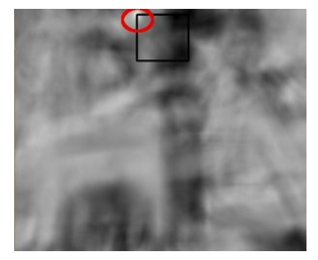
Example: Finding Same Objects on Images
https://docs.opencv.org/2.4/doc/tutorials/imgproc/histograms/template_matching/template_matching.html

Slide 13
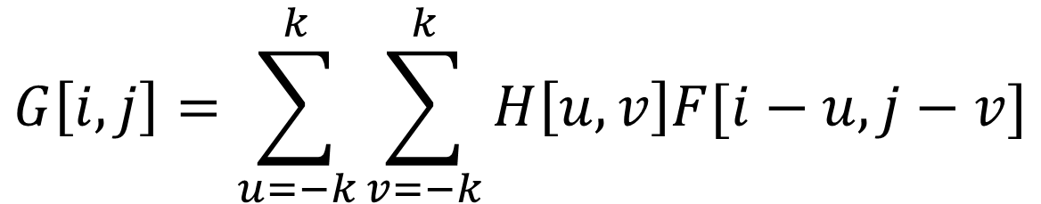
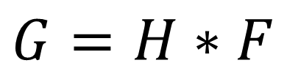
Convolution
Let $F$ be the image, $H$ be the kernel (of size 2k+1 x 2k+1),
G be the output image
$$G\left[i,j\right]=\sum_{u=−k}^{k}{\sum_{v=−k}^{k}{H\left[u,v\right]F[i−u,j−v]}}$$
Only difference is that the kernel is “flipped” horizontally and vertically.
This is called a convolution operation:
$$G=H∗F$$

Slide 14
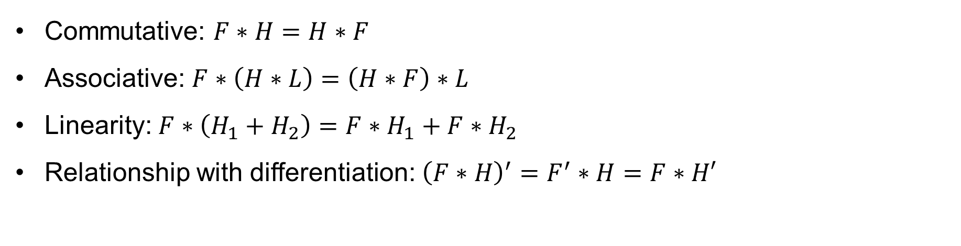
Property: Commutative, Associative, and Linearity
Commutative: $F∗H=H∗F$
Associative: $F∗\left(H∗L\right)=\left(H∗F\right)∗L$
Linearity: $F∗\left(H_{1}+H_{2}\right)=F∗H_{1}+F∗H_{2}$
Relationship with differentiation: ${\left(F∗H\right)}^{′}=F^{′}∗H=F∗H′$

Slide 15
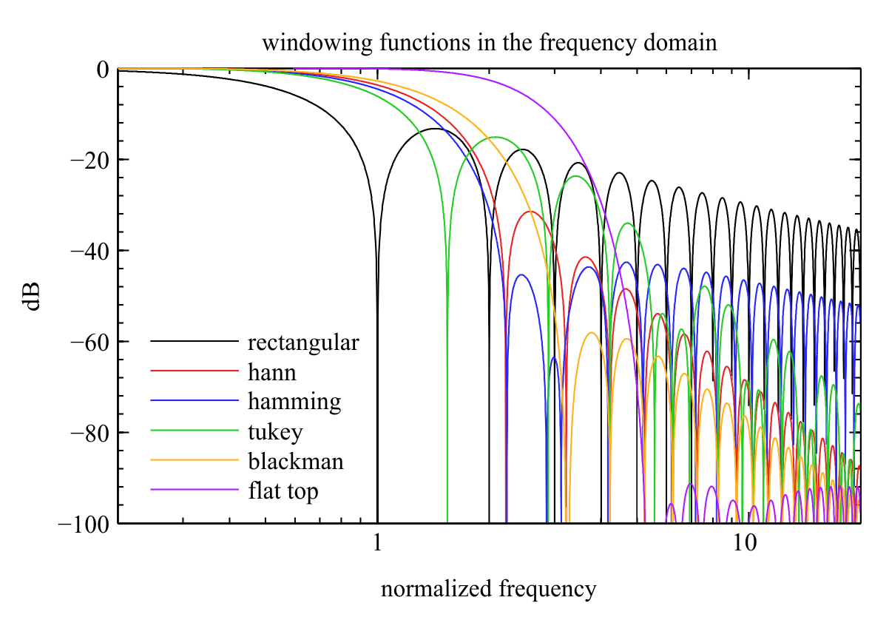
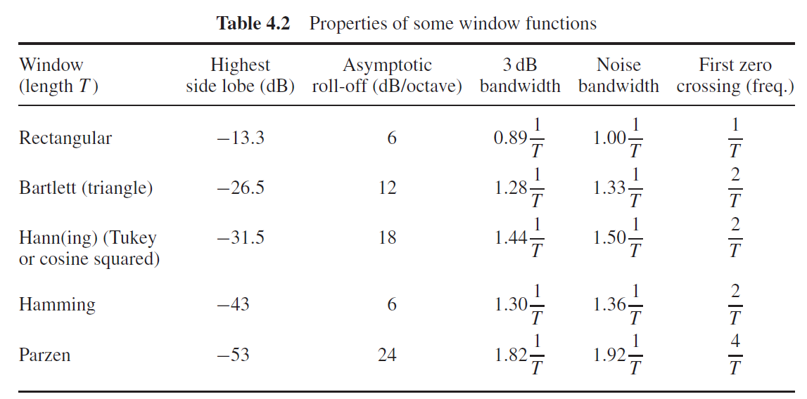
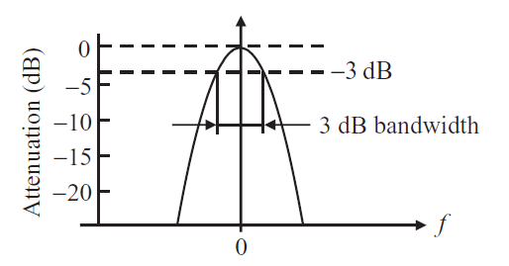
Example: Signal Filtering

Slide 16
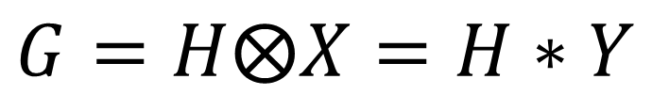


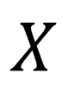
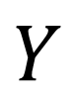
Difference between Cross-Correlation and Convolution
$$X$$
$$Y$$
The basic difference between convolution and cross-correlation is that the convolution process rotates the kernel by 180 degrees and conduct cross-correlation.
A | B | C
D | E | F
G | H | I
I | H | G
F | E | D
C | B | A
Usage
Cross-Correlation: Process to measure a similarity between two signals.
Convolution: Process to transform a signal to another signal.
$$G=H⨂X=H∗Y$$
$$⨂$$
cross-correlation
$$⨂$$
convolution
Notes:
https://www.mathworks.com/matlabcentral/answers/264746-difference-between-convolution-and-correlation

Slide 17
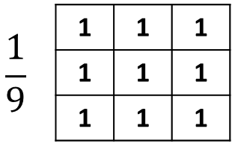
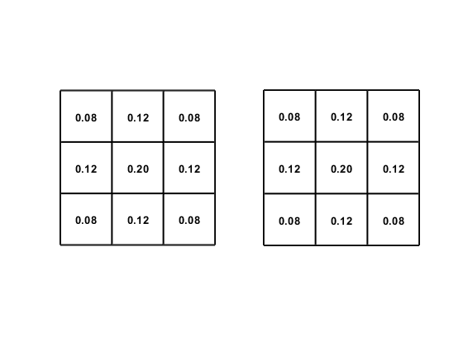
Filters
0 | 0 | 0
0 | 1 | 0
0 | 0 | 0
0 | 0 | 0
0 | 0 | 1
0 | 0 | 0
-0.11 | -0.11 | -0.11
-0.11 | 1.89 | -0.11
-0.11 | -0.11 | -0.11

Slide 18


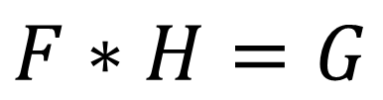
Linear Filter: Generating an Identical Image
$$∗$$
0 | 0 | 0
0 | 1 | 0
0 | 0 | 0
$$=$$
$$F∗H=G$$

Slide 19
Filters
0 | 0 | 0
0 | 1 | 0
0 | 0 | 0
0 | 0 | 0
0 | 0 | 1
0 | 0 | 0
-0.11 | -0.11 | -0.11
-0.11 | 1.89 | -0.11
-0.11 | -0.11 | -0.11

Slide 20
Linear Filter: Shifting Pixels
$$∗$$
0 | 0 | 0
0 | 0 | 1
0 | 0 | 0
$$=$$
$$F∗H=G$$

Slide 21
Filters
0 | 0 | 0
0 | 1 | 0
0 | 0 | 0
0 | 0 | 0
0 | 0 | 1
0 | 0 | 0
-0.11 | -0.11 | -0.11
-0.11 | 1.89 | -0.11
-0.11 | -0.11 | -0.11

Slide 22

Linear Filter: Blurring
$$∗$$
1 | 1 | 1
1 | 1 | 1
1 | 1 | 1
$$=$$
$$\frac{1}{9}$$
$$F∗H=G$$

Slide 23
Filters
0 | 0 | 0
0 | 1 | 0
0 | 0 | 0
0 | 0 | 0
0 | 0 | 1
0 | 0 | 0
-0.11 | -0.11 | -0.11
-0.11 | 1.89 | -0.11
-0.11 | -0.11 | -0.11

Slide 24
Linear Filter: Sharpening
$$∗$$
-0.11 | -0.11 | -0.11
-0.11 | 1.89 | -0.11
-0.11 | -0.11 | -0.11
$$=$$
$$F∗H=G$$

Slide 25
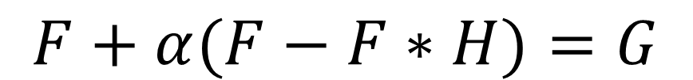




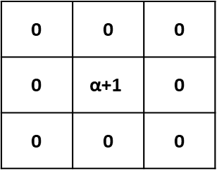
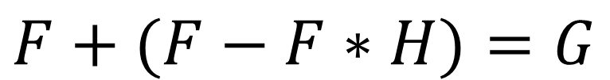
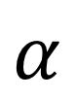
How the Sharpening Filter Works
0 | 0 | 0
0 | 2 | 0
0 | 0 | 0
0.11 | 0.11 | 0.11
0.11 | 0.11 | 0.11
0.11 | 0.11 | 0.11
-0.11 | -0.11 | -0.11
-0.11 | 1.89 | -0.11
-0.11 | -0.11 | -0.11
$$−$$
$$=$$
$$F+(F−F∗H)=G$$
0 | 0 | 0
0 | $$\text{α}\text{+1}$$ | 0
0 | 0 | 0
0.11 | 0.11 | 0.11
0.11 | 0.11 | 0.11
0.11 | 0.11 | 0.11
-0.11α | -0.11α | -0.11α
-0.11α | 1+0.89α | -0.11α
-0.11α | -0.11α | -0.11α
$$−$$
$$=$$
$$α$$
$$F+α(F−F∗H)=G$$

Slide 26
How the Sharpening Filter Works (Signal Example) (Continue)

Slide 27
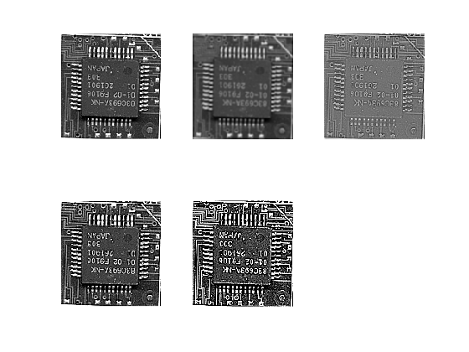
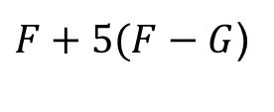
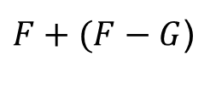
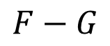
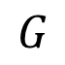
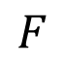
How the Sharpening Filter Works (Image Example)
$$F$$
$$G$$
$$F−G$$
$F+5(F−G$)
$F+(F−G$)

Slide 28
Filters
0 | 0 | 0
0 | 1 | 0
0 | 0 | 0
0 | 0 | 0
0 | 0 | 1
0 | 0 | 0
-0.11 | -0.11 | -0.11
-0.11 | 1.89 | -0.11
-0.11 | -0.11 | -0.11

Slide 29
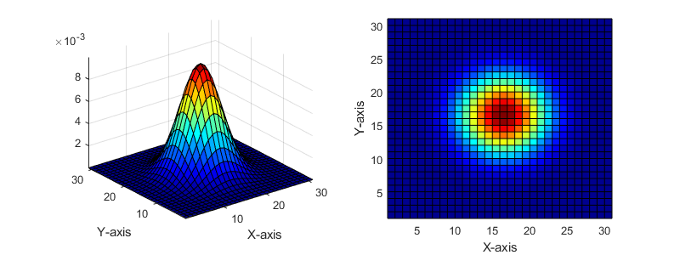
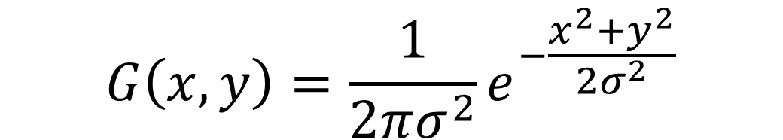
Gaussian Kernel
$$G\left(x,y\right)=\frac{1}{2πσ^{2}}e^{−\frac{x^{2}+y^{2}}{2σ^{2}}}$$

Slide 30
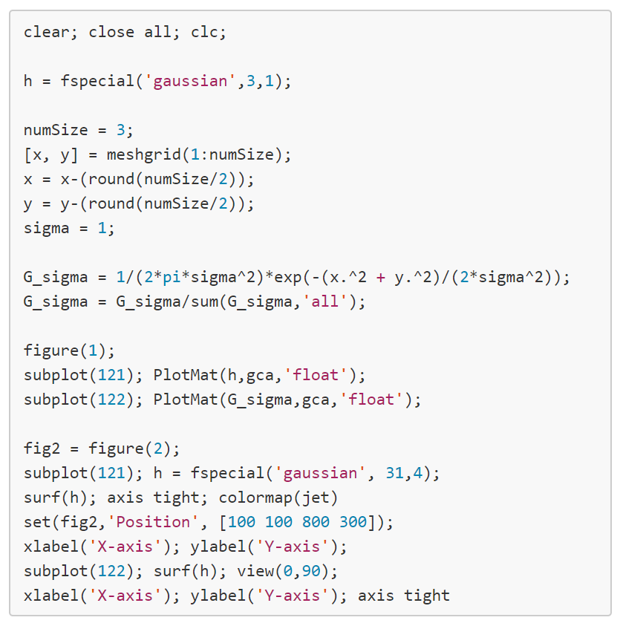
Gaussian Filter

Slide 31
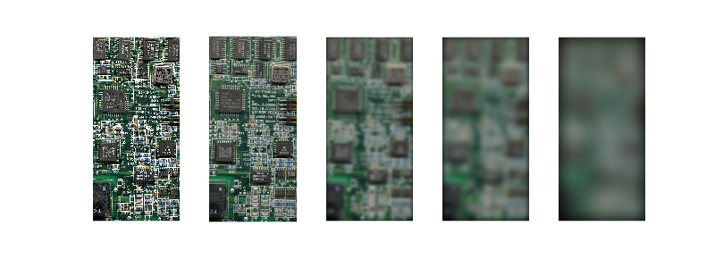
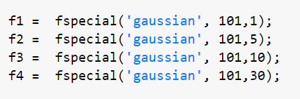
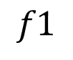
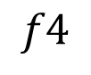
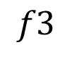
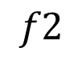
Effect of Gaussian Window Sizes
$$f1$$
$$f2$$
$$f3$$
$$f4$$

Slide 32


Difference of the Between a Gaussian Filter and Box Filter
https://dsp.stackexchange.com/questions/208/what-should-be-considered-when-selecting-a-windowing-function-when-smoothing-a-t
https://stackoverflow.com/questions/31131672/difference-between-mean-and-gaussian-filter-in-result
Notes:
https://stackoverflow.com/questions/31131672/difference-between-mean-and-gaussian-filter-in-result

Slide 33
Template Matching
Count_brick_wall.m

Slide 34


Challenges (template matching) !!!!!!

Slide 35

Preview: Convolution Neural Network

Slide 36

Preview: Convolution Neural Network (Continue)
http://web.eecs.umich.edu/~honglak/icml09-ConvolutionalDeepBeliefNetworks.pdf

Slide 37
Slide Credits and References
Lecture notes: Rob Fergus.
Lecture notes: Steve Seitz
Lecture notes: Mohammad Jahanshahi
Lecture notes: Svetlana Lazebnik
Lecture notes: Derek Hoiem
Lecture notes: Ioannis (Yannis) Gkioulekas
Lecture notes: Robert Collins
Lecture notes: Jason Corso
Lecture notes: Gordon Wetzstein
Lecture notes: Noah Snavely

